Slide 1
Feature Extraction and Price Prediction for Mobile Phones
PROJECT
ON
NAME: MINAL DEVIKAR
INSTITUTION: DIGICHROME ACADEMY

Slide 2
PROJECT OVERVIEW
In this project, I worked with a dataset that contains detailed information about various mobile phones, including their model, color, memory, RAM, battery capacity, rear camera specifications, front camera specifications, presence of AI lens, mobile height, processor, and, most importantly, the price.
My goal is to develop a predictive model for mobile phone prices.

Slide 3
PROBLEM STATEMENT
ProblemStatementwastodesignamodule:
•
WhichisUserFriendly.
•
Whichwillrestricttheuserfromaccessingotherusersdata.
•
Whichwillhelptheadministratortohandleallthechanges.
•
TheSystemwillbecompletelymenudrivensothattheuserswillhavenoproblemsinusingalltheoptions.
•
Thesystemwillbeefficientandfastinresponse.
•
Thesystemwillbecustomizedaccordingtotheneeds.
AD
The organization is keen to enhance its pricing strategy by gaining a deeper understanding of the key features that influence the prices of mobile phones in today's highly competitive market
Develop a predictive model for mobile phone prices based on detailed specifications including model, color, memory, RAM, battery capacity, rear camera specifications,front camera specifications, presence of AI lens, mobile height,
and processor.

Slide 4
DATA OVERVIEW
Unnamed: 0: An index column, possibly representing row numbers or IDs.
Model: The model name of the mobile phone.
Colour: The color of the mobile phone.
Memory: Amount of storage memory in the phone (in GB).
RAM: RAM capacity of the phone (in GB).
Battery_: Battery capacity of the phone (assuming in mAh).
Rear Camera: Specification of the rear camera.
Front Camera: Specification of the front camera.
AI Lens: Presence of AI lens (likely a binary indicator, 1 for yes, 0 for no).
Mobile Height: Height of the mobile phone (in mm).
Processor_: Processor specification of the phone.
Price: Price of the mobile phone.

Slide 5
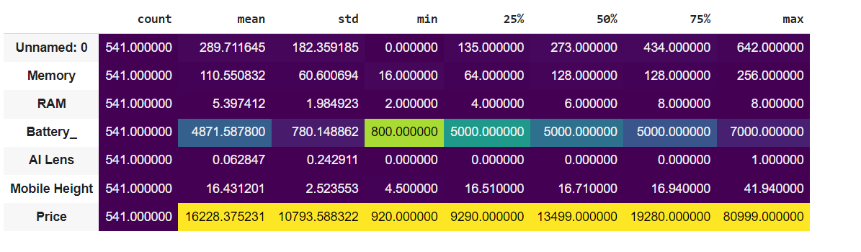
Data Description (summary of statistics)

Slide 6
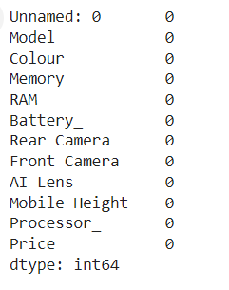
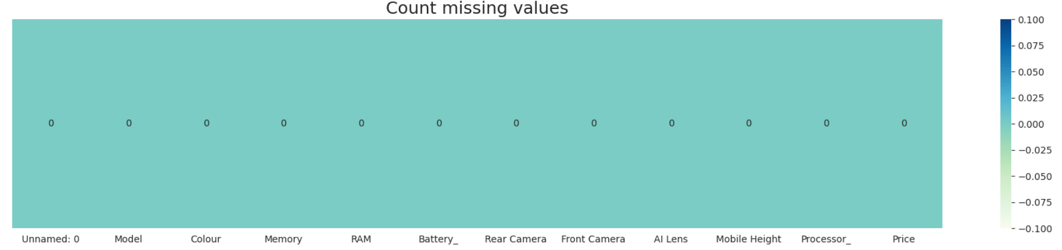
DATA CLEANING
1. Handling Missing Values
Identify Missing Values
No null values

Slide 7
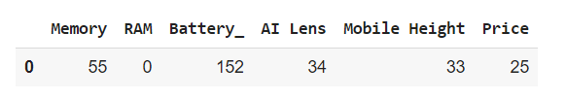
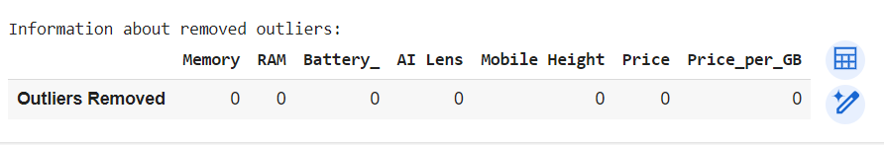
TREATING WITH OUTLIERS
Outliers Detected
After Removing outliers

Slide 8
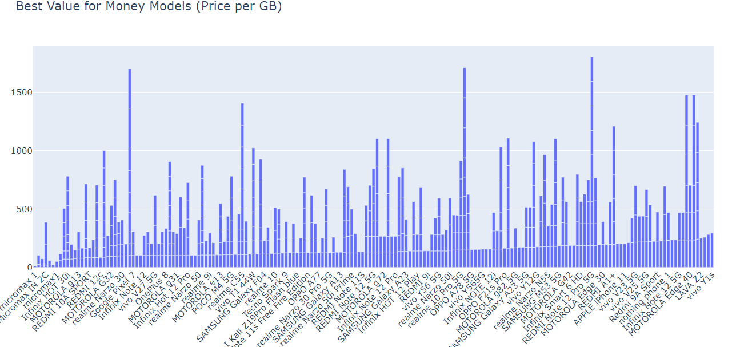
Best Value for Money Models (Price per GB)

Slide 9
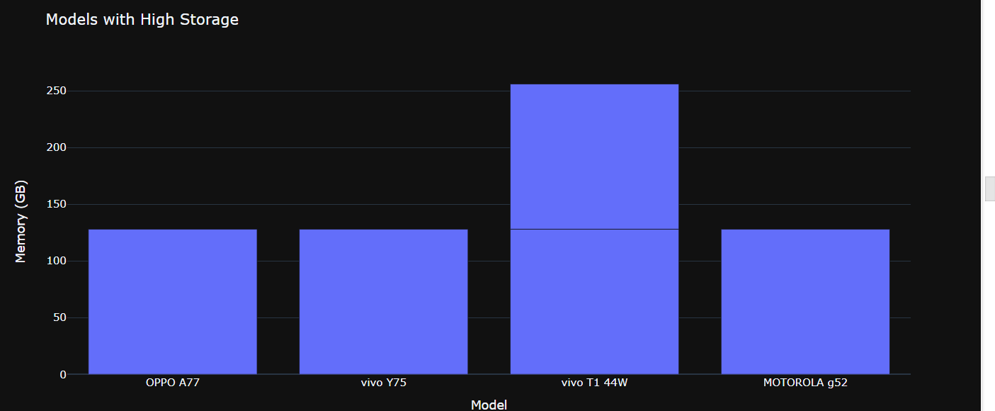
Whar are model with high storage ?
The dataset highlights models with high storage capacity, specifically 128 GB, such as the OPPO A77, vivo Y75, vivo T1 44W, and MOTOROLA g52. The presence of multiple entries for some models, like the vivo T1 44W, suggests potential duplicates or different variants of the same model.

Slide 10
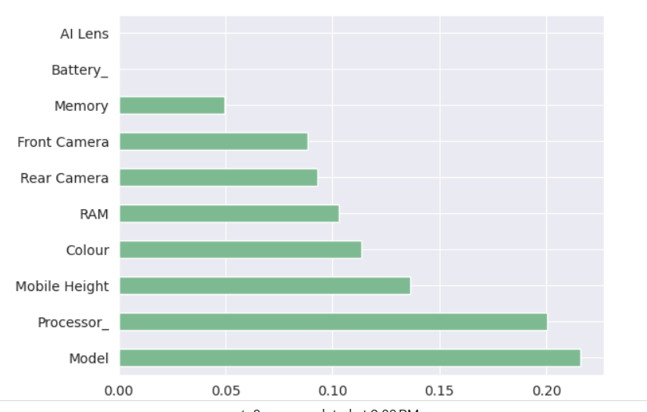
FEATURE EXTRACTION
Model and Processor_ are the most important features, each with an importance value close to 0.20.
Mobile Height is also a significant feature with an importance value close to 0.15.
Colour, RAM, Rear Camera, and Front Camera have moderate importance, each around 0.10.
Memory and Battery_ have lower importance, with values around 0.05.
AI Lens has the least importance, contributing very little to the model.

Slide 11
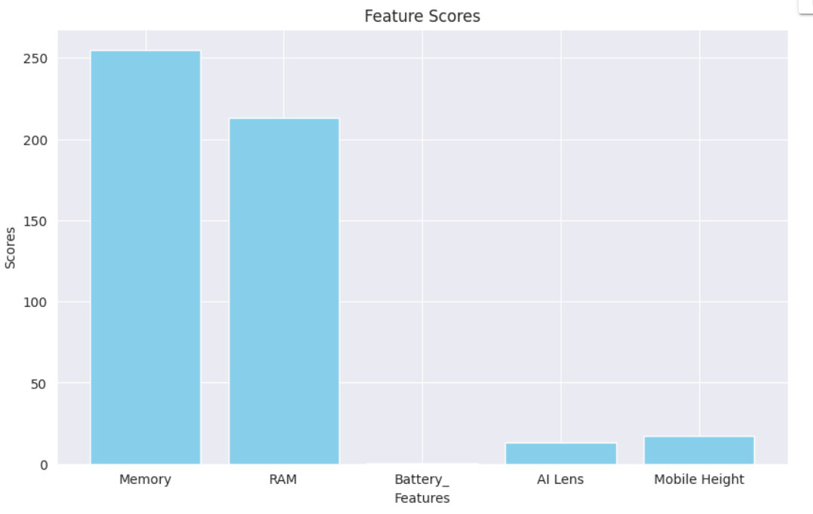
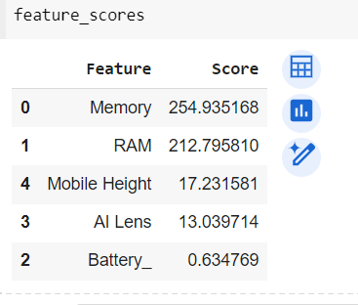
SELECTKBEST WITH F_REGRESSION
Memory and RAM are the primary contributors to the model's performance, with scores of 254.935168 and 212.795810, respectively. In contrast, Mobile Height, AI Lens, and Battery_ have significantly lower importance.

Slide 12
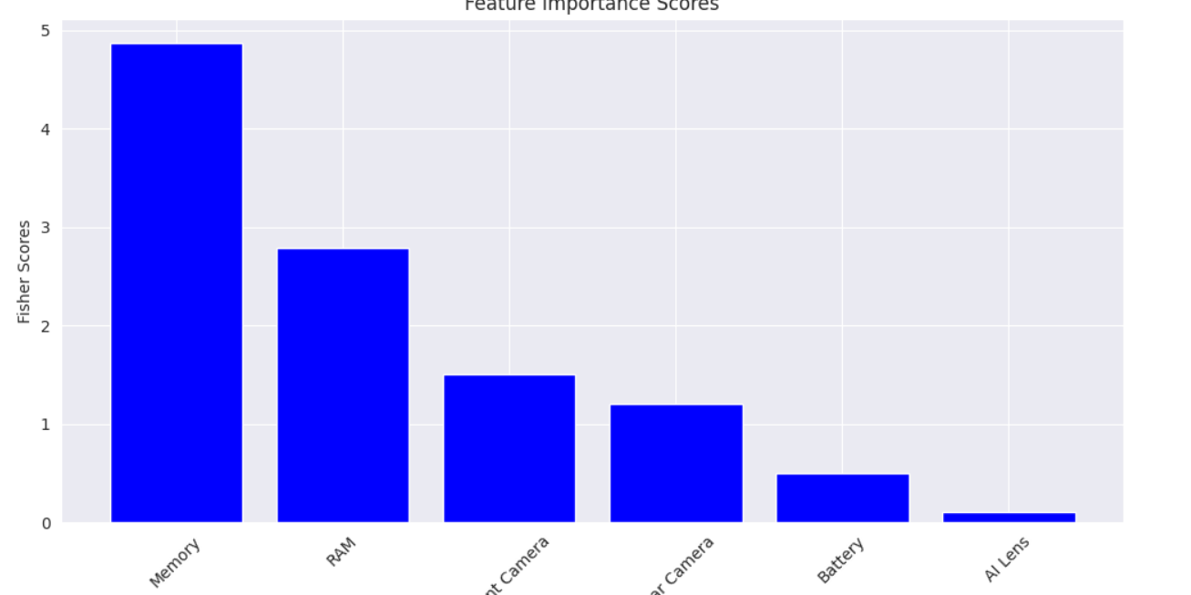
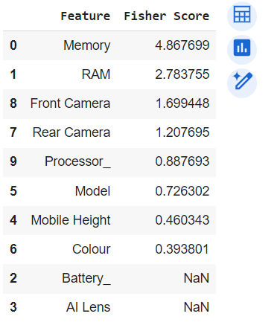
FISHER’S SCORE:
Ranks variables based on their Fisher score, which measures the separation between classes.
The Fisher scores plot reveals that Memory (4.867699) and RAM (2.783755) are the most important features. Other features like Front Camera and Rear Camera have moderate importance, while Battery_ and AI Lens have no significant impact

Slide 13
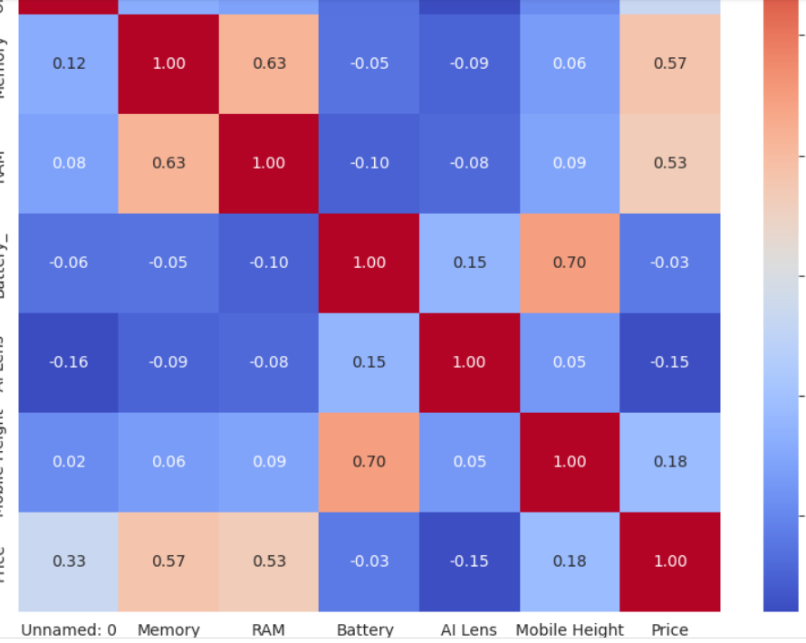
Correlation Analysis
Most correlations between these features are weak, except for the strong positive relationships between Memory and RAM (0.625), and Battery and Mobile Height (0.696). This indicates that while some features like memory and RAM, and battery capacity and mobile height tend to increase together, most other features do not show strong linear relationships.

Slide 14
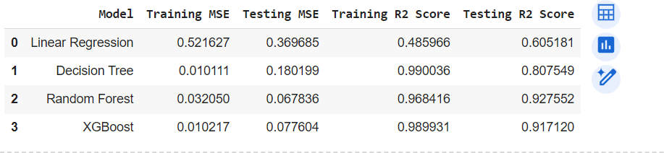
RESULT
Test performance
v
Decision Tree: Achieves very low training MSE (0.010111) and reasonable testing MSE (0.180199), indicating potential
overfitting but good generalization with an excellent testing R2 score of 0.807549.
Random Forest: Balances bias and variance well with moderate training MSE (0.032050) and low testing MSE (0.067836).
It demonstrates strong predictive power with high R2 scores for both training (0.968416) and testing (0.927552) datasets.

Slide 15
CONCLUSION
Random Forest and XGBoost are the top performers based on the testing R² scores. Both models have high R² scores on both training and testing datasets, indicating that they are highly effective and generalize well to unseen data.
Overfitting Concerns: The Decision Tree model shows signs of overfitting, with a significant drop in performance from training to testing data.
Moderate Performer: Linear Regression is the least effective among the four models, with moderate R² scores and higher MSE values.

